Slide 1
Webometrics, Altmetrics and Web Analytics
Prof. Tom Kwanya

Slide 2
Webometrics
This is a ranking system of the world’s universities based on a composite indicator that takes into account both the volume of the Web content and the visibility and impact of these web publications.
The ranking is published by the Cybermetrics Lab, a research group of the Spanish National Research Council (CSIC) located in Madrid.

Slide 3
Webometrics
The original aim was to promote academic web presence; supporting the open access initiatives for increasing the transfer of scientific and cultural knowledge to society.
Has ranked universities worldwide every six months since 2004.
The latest ranking (December 2024) placed TUK at #8 out of 125 institutions in Kenya.

Slide 4
Webometrics
The objective is not to evaluate websites; their design or usability or the popularity of their contents.
The aim of the ranking is to improve the presence of the academic and research institutions on the Web and to promote the open access publication of scientific results.
The ranking started in 2004 and is updated every January and July.

Slide 5
Webometrics
Presence – accounts for 20% of the score. Total number of web pages; considers all formats of documents on the web site.
Impact – accounts for 50% of the score. Measured using backlinks the web site receives from other web sites external to the university. The number and diversity of links matter.

Slide 6
Webometrics
Openness – accounts for 15% of the score. Measures the number of documents published in the institutional repository. Currently focusing on recent publications (from 2007).
Excellence – accounts for 15% and counts the articles published in high impact international journals.

Slide 7
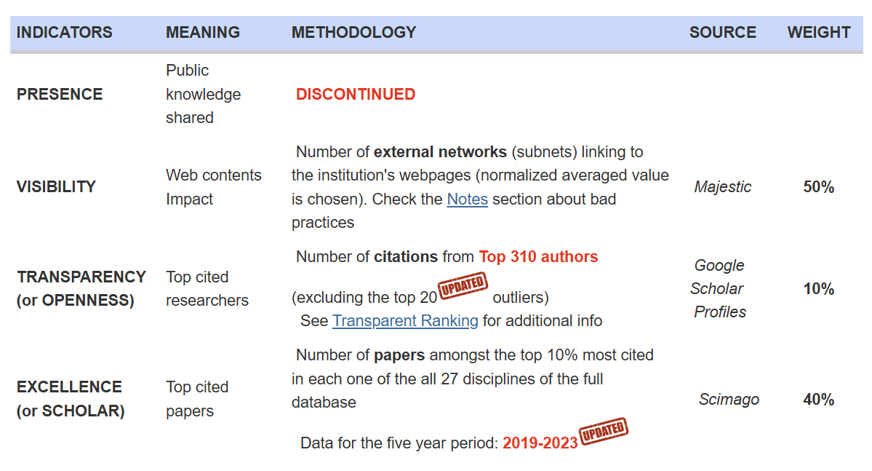
Webometrics

Slide 8
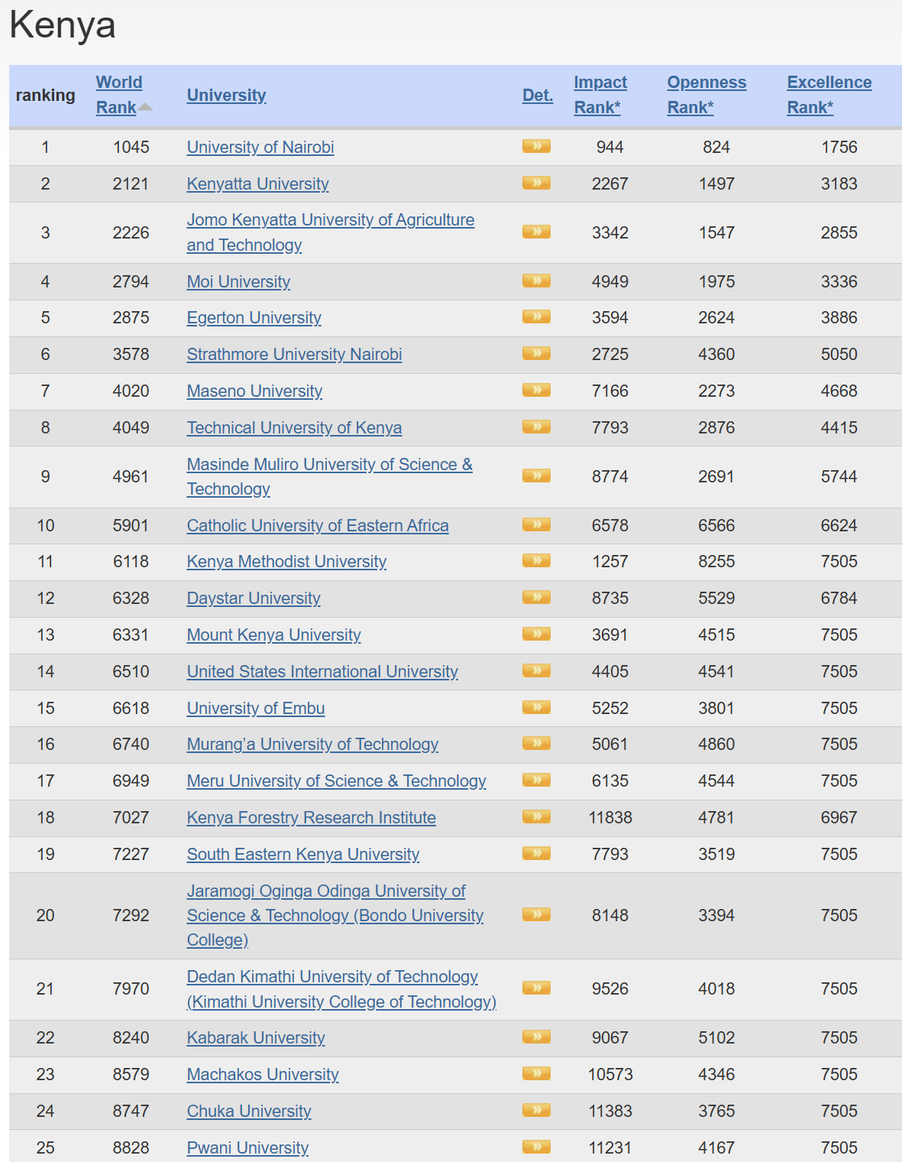

Slide 9
Limitations of Webometrics
Focused on size (number of pages).
Favours large, old universities with many members of staff.
Complications about affiliations of mobile academics.
Open to manipulation e.g. by creating foxy web sites to provide in-links.
Methodology changes frequently.

Slide 10
Altmetrics
Short for “alternative metrics”
Altmetrics is anchored on the understanding that conversations of scholarly nature happen in day-to-day interactions.
Most of these interactions and conversations happen online.
Using conventional metrics and approaches leave out these important conversations.

Slide 11
Altmetrics
Altmetrics basically measure the following:
Attention – number of people exposed to and engaged with a scholarly work.
Dissemination – where and why a piece of research is being discussed and shared, both among other scholars and in the public sphere.
Influence and impact – digital footprints and digital shadows; digital reputation; impact on peers and society at large.

Slide 12
Altmetrics
Some of the interactions/conversations “counted” by altmetrics include:
Article downloads
Article views
Article sharing
Tagging
Following
Tweeting and retweeting

Slide 13
Altmetrics
The advantages of using altmetrics over the traditional metrics include:
Quicker
Inclusive
Flexible
Altmetrics is not seeking to replace the traditional metrics. It just provides other perspectives; it is complementary.

Slide 14
Web Analytics
Web analytics is the process of analyzing the behavior of visitors to a Web site.
Web analytics is often used as part of customer relationship management analytics
May include tracking the behaviour of customers within the Web site e.g. the sites from which customers most often arrive.

Slide 15
Web Analytics
Web analytics can be used to:
Assess likelihood that a given customer will repurchase a product after having purchased it in the past;
personalize the site to customers who visit it repeatedly;
monitor the dollar volume of purchases made by individual customers or by specific groups of customers;

Slide 16
Web Analytics
Web analytics can be used to:
observe the geographic regions from which the most and the least customers visit the site and purchase specific products; and
predict which products customers are most and least likely to buy in the future.
The objective is to promote specific products to those customers most likely to buy them, and to determine which products a specific customer is most likely to purchase.

Slide 17
Web Analytics
Web analytics approaches include:
Web server log analysis
Page tagging
Geolocation of visitors based on IP
Click analytics
Customer lifecycle analytics
Packet sniffing
Hybrid approaches

